Slide 1
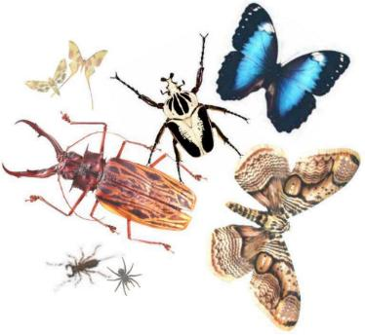
Bug Splat an ABC game

Slide 2
Directions
Print cut out and laminate the bug cards
To play SPLAT you will need a fly swatter. One person calls out a letter and players try to find and swat the bug with that letter on it.
Card can be removed from play after it has been swatted. (If there are multiple players swatted bug cards can be put into a jar and at the end of the game they can be counted to see which player has the most bugs in their jar.
To play MATCH cards are placed in rows face down. Players take turns turning over two cards if they turn over a match (same capital and lower case letter) they collect the bugs (cards) and put them in a jar. Player with most bugs in their jar wins.
Cards can be used to but in ABC order as well.
Cards can be put into a container, players pull cards out of the container and identify the letter on the card. If correct the bug can be set free if incorrect the bug goes back into the container.

Slide 3
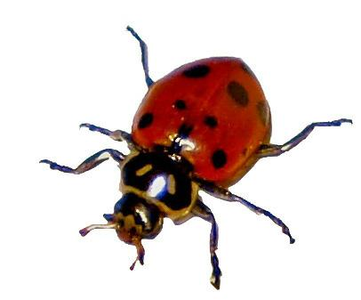
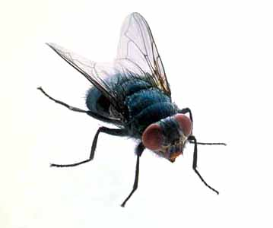
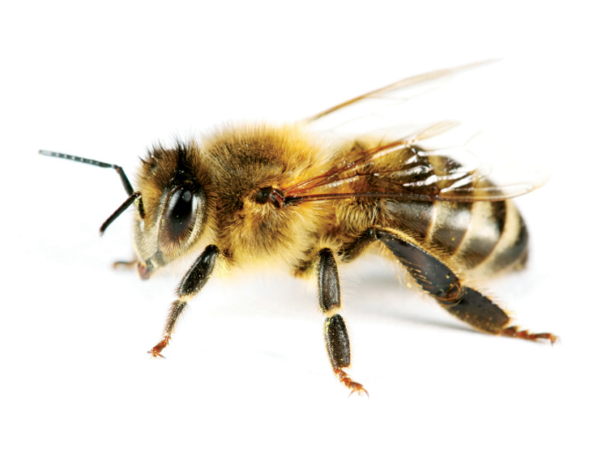
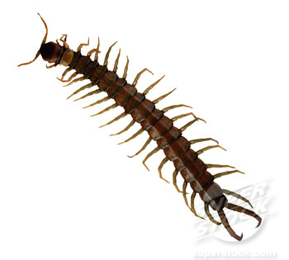
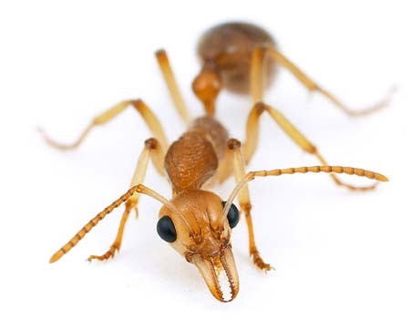
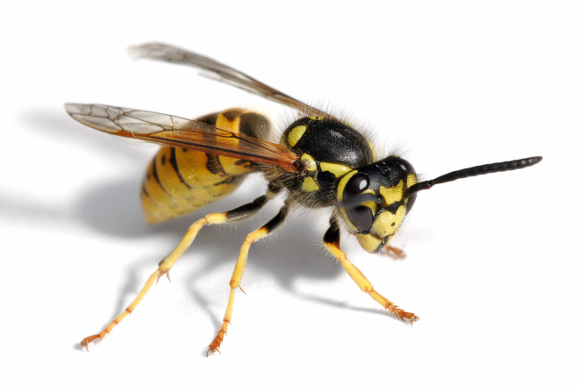
am
are
ate
be
but
came

Slide 4
am
are
ate
be
but
came

Slide 5
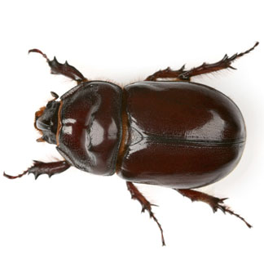
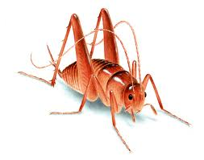
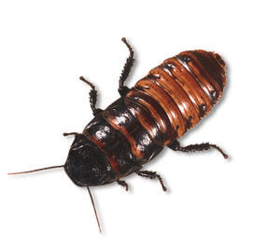
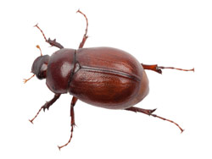
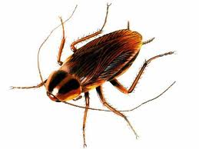
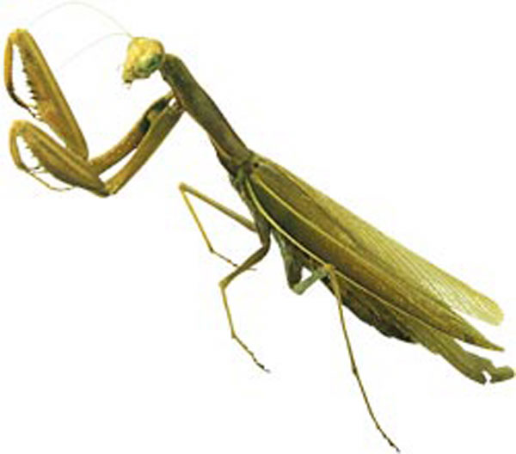
eat
did
do
he
get
have

Slide 6
eat
did
do
he
get
have

Slide 7
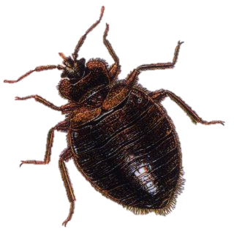
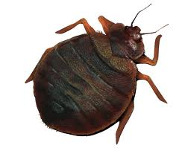
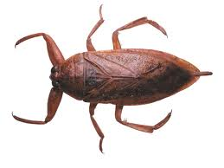
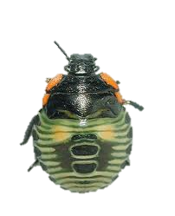
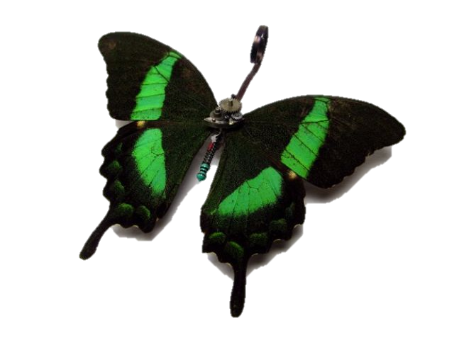
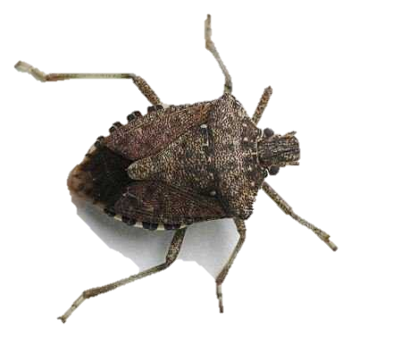
into
like
must
now
new
she

Slide 8
into
like
must
now
new
she

Slide 9
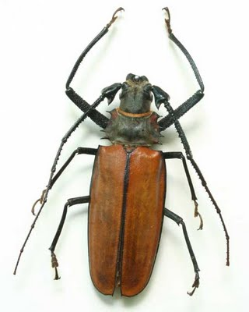
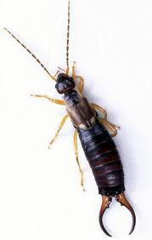
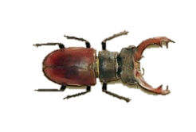
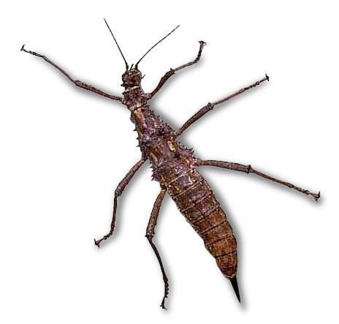
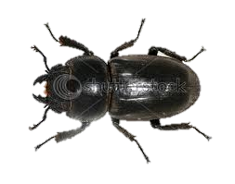
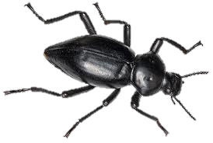
soon
there
they
what
want
was

Slide 10
soon
there
they
what
want
was

